Slide 1
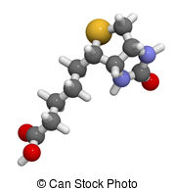
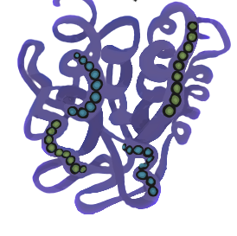
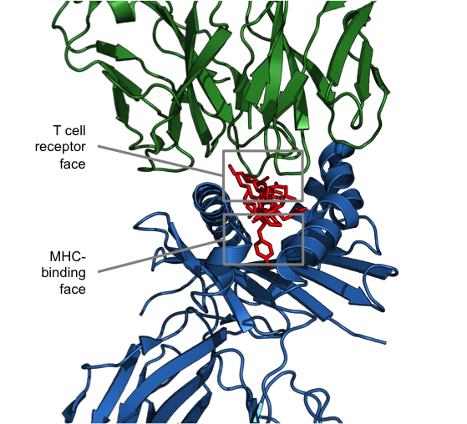
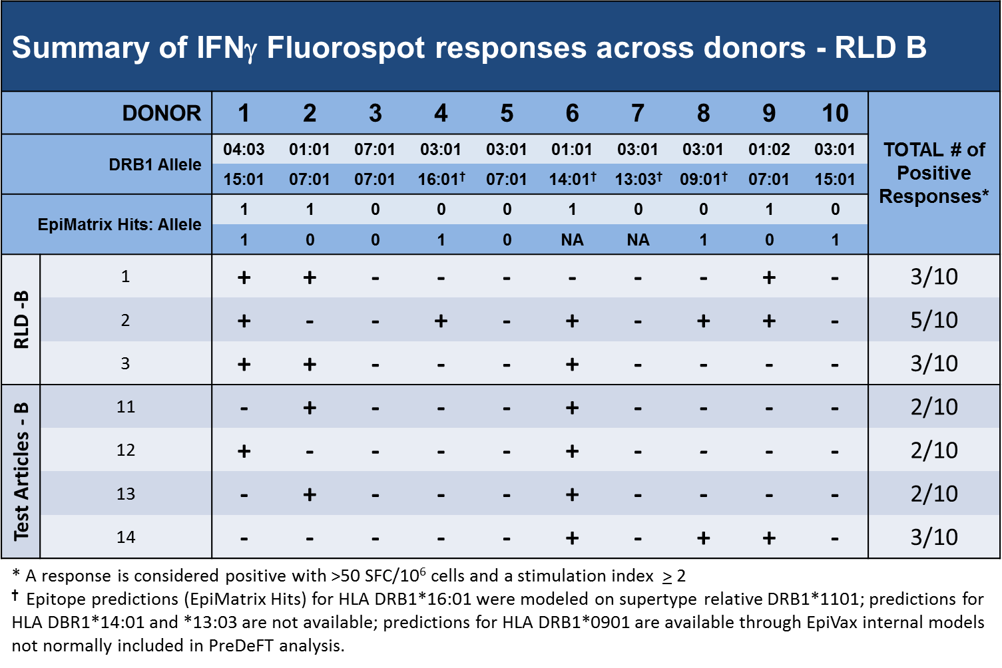
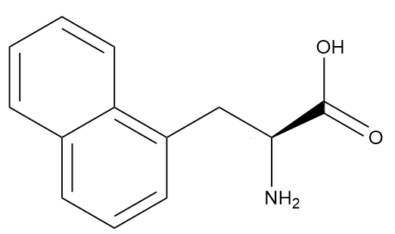
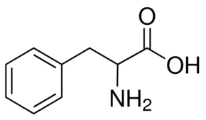
Innovative Preclinical Assessment Tools for Safety and Efficacy of Protein and Peptide Therapeutics … Of Peptides and P-ANDAS
Brian J Roberts PhD¹, Frances Terry MPH¹, Lenny Moise PhD¹ , Christine Boyle PhD¹,
William Martin and Anne S. De Groot MD¹,²
¹EpiVax, Inc.; ²Professor (Research) and Director, Institute for Immunology and Informatics, University of Rhode Island, USA
Abstract
PANDA Overview
The US Food and Drug Administration (FDA) recently released a new draft guidance enabling generic manufacturers of peptide drugs to file an Abbreviated New Drug Application (ANDA) for synthetic peptide drug products.
Processes for manufacturing the generic and reference drug (RLD) are not equivalent, leading to manufacturing related impurities.
Manufacturers are required to prove that the synthetic peptide product does not contain impurities with an increased risk of immunogenicity that could result in the development of anti-drug antibodies.
We use both in silico analysis and in vitro validation assays to perform immunogenicity risk assessment of peptide generics. This process is referred to as the PANDA assay which can be used to support generic peptide drug equivalency in an ANDA application.
in silico
in vitro
in vitro
review
Epitope Prediction
HLA Binding
T cell Activity
Literature
EpiVax’s Expert Opinion on the Human Immune Response to RLD vs New Drug Candidate Synthetic Peptide Equivalent
Impact of Manufacturing Impurities on T cell Epitopes
HLA Class II Binding Assay
Creating New Epitopes
Deleting Epitopes
Day 0
Day 1
Day 2
Streptavidin
Labeled
Europium
Non-binder
8
Binder
1
2
3
4
5
6
7
9
10
11
1
2
3
4
5
6
7
8
9
10
11
Deletions
P1
P4
P6
P9
P1
P4
P6
P9
Binder
Non-binder
HLA Allele
1
2
3
4
6
7
8
9
10
11
1
2
3
4
6
7
8
9
10
11
+
P1
P4
P6
P9
P1
P4
P6
P9
Test Peptide
Binding reaction is neutralized
Deletion of Amino Acid 5 converts a non HLA-binding peptide into a peptide that will bind HLA.
Alternatively, deletion of Amino Acid 5 can result in a peptide that will no longer bind HLA
+
Incubate for 1hr
Binder
Non-binder
Biotinylated Tracer Peptide
1
2
3
4
5
6
7
8
9
10
11
1
2
3
4
5
6
7
8
9
10
11
P1
P4
P6
P9
P1
P4
P6
P9
L243 (anti HLA antibody)
Measure
Fluorescence
Non-binder
Duplications
2
3
4
5
6
7
8
9
10
11
Binder
Plate is washed and blocked
HLA-Peptide transferred to plate
1
2
P6
1
2
2
3
4
5
6
7
8
9
10
11
Plate (coating)
Overnight 4⁰C
P1
P4
P9
P1
P4
P6
P9
Duplication of Amino Acid 2 results in a peptide that will no longer bind HLA by shifting subsequent amino acids out of phase
Alternatively, duplication of Amino Acid 2 can result in a peptide that will bind HLA
Adapted from Steere et al, 2006
Incorporation of D-Amino Acids
Truncations
HLA-Class II Binding Assay: Peptides that are predicted to bind HLA are synthesized and assayed over a range of 7 concentrations in our HLA-binding assay. In brief, peptides are incubated overnight with soluble HLA and a biotin labeled competitor of moderate affinity. On day 2, the reaction is halted and the mixture is transferred to a plate coated with a pan anti-HLA antibody. On day 3, plates are developed by the addition of streptavidin-Europium and fluorescence is measured.
Binder
2
3
4
5
7
8
9
10
11
Binder
L
1
6
L
1
2
3
4
5
6
7
8
9
10
11
P1
P4
P6
P9
P1
P4
P6
P9
Non-binder
3
4
5
6
7
8
9
10
11
Non-binder
1
2
P6
P9
1
2
3
4
5
6
7
8
9
10
11
D
P1
P4
D
P1
P4
P6
P9
The incorporation of a D- amino acid at Amino Acid 1 turns this peptide into a non-binder
A truncation occurring after Amino Acid 1 turns this peptide into a non-binder
Epitope Prediction by EpiMatrix
In Vitro Immunogenicity Protocol (IVIP)
EpiMatrix Immunogenicity Scale
EpiMatrix
The ability of the test article (new Generic and impurities) and the RLD to stimulate a de novo T-cell response is compared to several controls including HSA (protein neg control), KLH (protein positive control) and a CEFT (peptide pool positive control).
14 days post exposure, cells are harvested and plated into pre-coated IFNγ ELISpot plates. Cells are restimulated and incubated overnight. On day 15, ELISpot plates are developed and sent to Zellnet Consulting Inc. for blind, independent analysis.
Tetanus Toxin (825-850)
-
40
-
Hepatitis C NPC NS3 (1248-1267)
-
30
-
Your Generic Peptide Impurity X
-
-
Peptide Drug
Influenza Hemagglutinin (306-319)
-
20
-
Mature
APC
HLA-peptide complex
Tetanus Toxin (947-963)
-
-
Human CLIP
-
-
Your Generic Peptide Impurity Y
Epstein-Barr Virus BHRF1 (171-189)
-
10
-
Epitope
-
00
-
-
-
Your Generic Peptide
Theoretical Minimum
-
-10
-
Your Generic Peptide Impurity Z
Innate Immunity
Adaptive Immunity
-
-
EpiVax uses EpiMatrix to predict T cell epitopes
EpiVax predicts both class I and class II HLA binding
HLA binding is a prerequisite for immunogenicity
Full suite of HLA-based predictions are available
-
-
EpiMatrix excess and shortfall in predicted aggregate immunogenicity relative to a random peptide standard
EpiMatrix Cluster Scores above ten are comparable to those of known promiscuous Class II epitopes, commonly used as positive controls in T cell assays and included for reference on the left side of the scale
DR11
DR8
JanusMatrix
Wullner/IVIP Timeline
Day 1:
-Isolate PBMCS from leukocyte reduction filter
-Set up primary culture
-Prepare samples for HLA typing
Day 4:
Half media exchange
Day 7:
Half media exchange
Day 11:
Half media exchange
Day 14:
-Harvest cells for Fluorospot (IFNγ/IL-2
-Stimulation 2
Day 15:
Fluorospot development
DR3
DR13
TCR
DR4
DR15
MHC
DR1
DR7
TCR
EpiVax tests for binding potential to the most common HLA molecules within each of the “supertypes”* shown to the left.
This allows us to provide results that are representative of >95% of human populations worldwide** without the necessity of testing each haplotype individually.
MHC/HLA
JanusMatrix is designed to predict the potential for cross-conservation between epitope clusters and the human proteome, based on conservation of TCR-facing residues in their putative HLA ligands.
This results in a more in depth analysis than typical alignment homology.
Modeling Unnatural Amino Acids
Example Peptide: AAAYLQMT[1Nal]LRTAAA
Since EpiMatrix does not predict for unnatural AA, 1-Nal is shown as “?”
When EpiMatrix cannot model HLA binding for modifications found in the impurity, we use a sensitivity analysis to find the best proxy.
The modified residue is replaced with a neutral placeholder “X”. We then replace “X” with each of the natural 20 amino acids.
The goal is to determine if any residue at these positions can lead to a significant increase or decrease in predicted HLA binding potential.
We also compare the properties of the chemically modified residues with the naturally occurring amino acids and pick the “best-matched” residue as a proxy
Flank
Y
L
Q
M
TCR
Flank
References
T
?
L
R
T
1-Nal
HLA
1Nal = 1-naphthyl-L-alanine
Steere AC, Klitz W, Drouin EE, et al. Antibiotic-refractory Lyme arthritis is associated with HLA-DR molecules that bind a Borrelia burgdorferi peptide . J Exp Med 2006; 203: 961–971.
Wullner D, Zhou L, Bramhall E, et al. Considerations for optimization and validation of an in vitro PBMC derived T cell assay for immunogenicity prediction of biotherapeutics. Clin Immunol 2010; 137: 5–14.
*Lund et al. Definition of Supertypes for HLA Molecules Using Clustering of Specificity Matrices. Immunogenetics. 2004; 55(12):797–810.
**Southwood et al. Several Common HLA-DR Types Share Largely Overlapping Peptide Binding Repertoires. J Immunol. 1998; 160(7):3363–73.
When 1-Nal is replaced with Phenylalanine, chosen for its structural and chemical similarities to 1-Nal, we find that the peptide can bind across multiple frames.
F
Notes:
Duplications: replace deletion by dublication at right side Top left not ok either, header and text

